Slide 2

10
Lesson 10
Periodical Test and Review I

Slide 3
We have learnt…
Counting I-Basic Rule
Counting II-Permutation
Counting III-Combination
Counting-Balls and Boxes
Triangle Area and Area Method
Similar Triangle III
Coordinate Geometry III

Slide 4
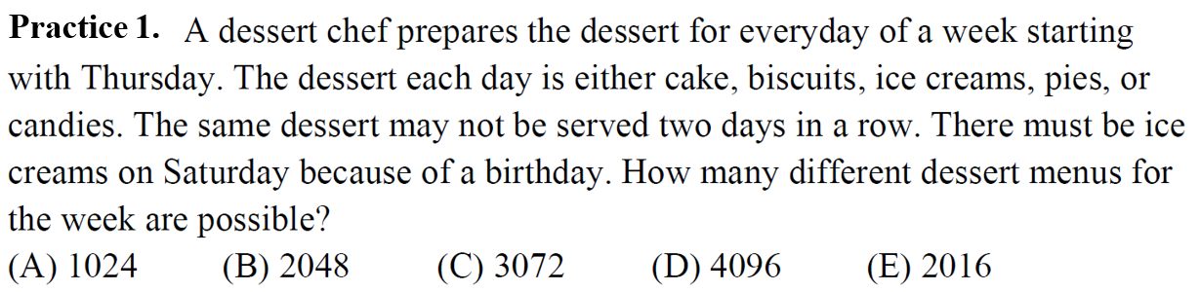
Practice 1

Slide 5
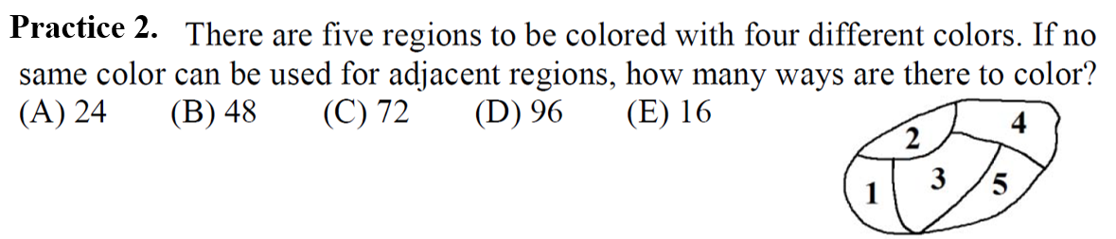
Practice 2

Slide 6
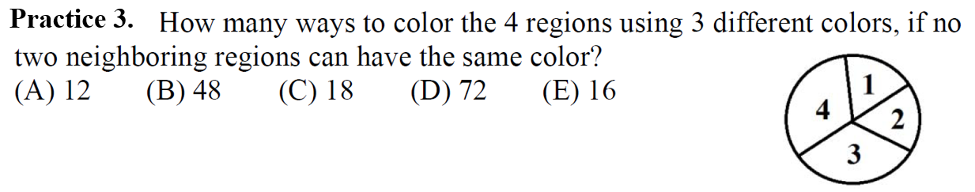
Practice 3

Slide 7
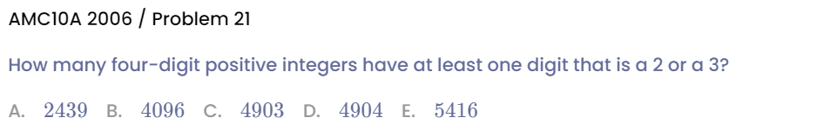
Practice 4

Slide 8
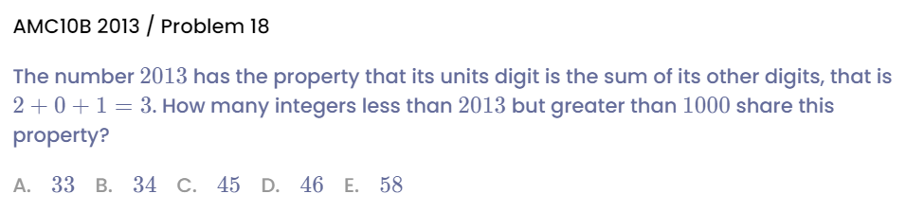
Practice 5

Slide 9
We have learnt…
Counting I-Basic Rule
Counting II-Permutation
Counting III-Combination
Counting-Balls and Boxes
Triangle Area and Area Method
Similar Triangle III
Coordinate Geometry III

Slide 10
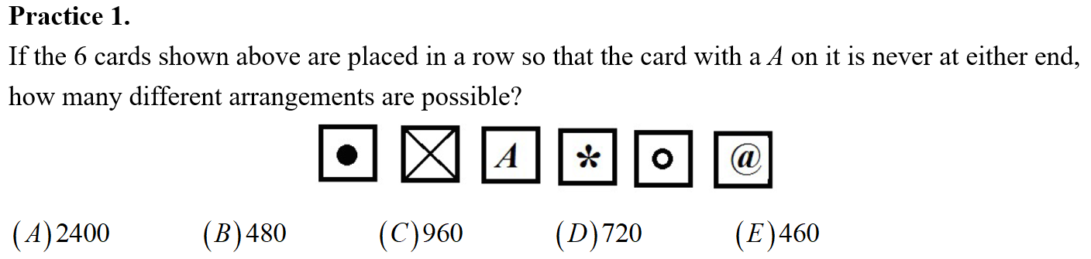
Practice 1

Slide 11
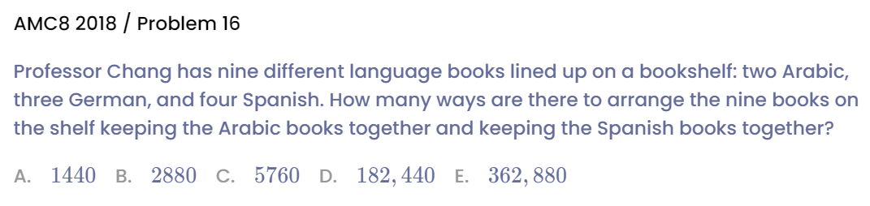
Practice 2

Slide 12
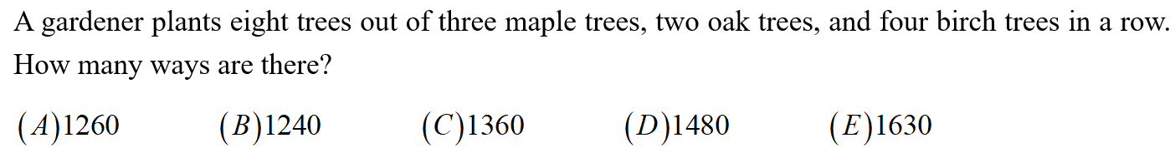
Practice 3

Slide 13
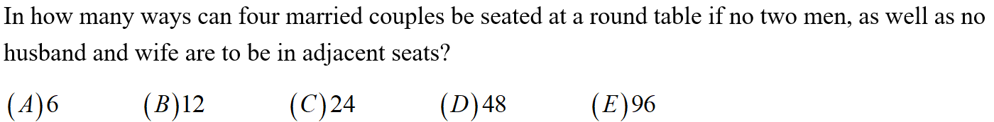
Practice 4

Slide 14
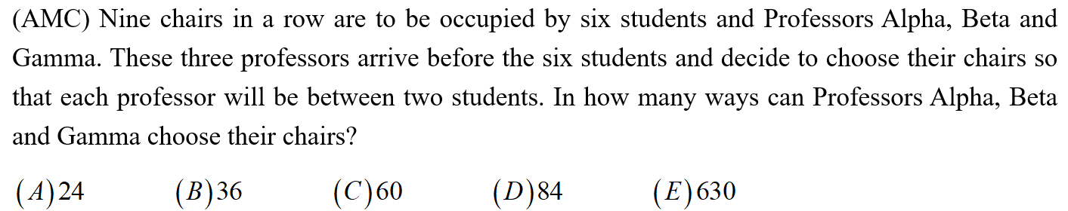
Practice 5

Slide 15
We have learnt…
Counting I-Basic Rule
Counting II-Permutation
Counting III-Combination
Counting-Balls and Boxes
Triangle Area and Area Method
Similar Triangle III
Coordinate Geometry III

Slide 16
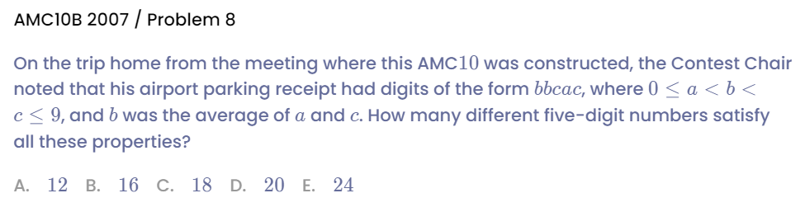
Practice 1

Slide 17
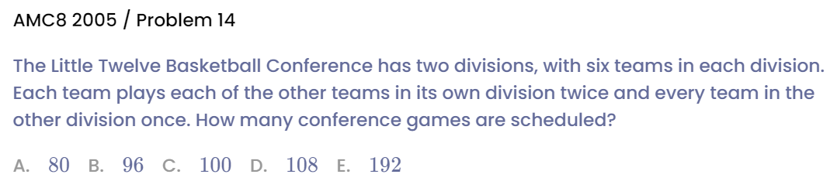
Practice 2

Slide 18
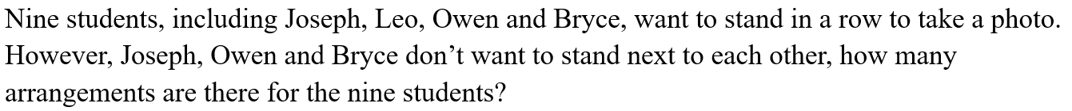
Practice 3

Slide 19
Practice 4

Slide 20
Practice 5

Slide 21
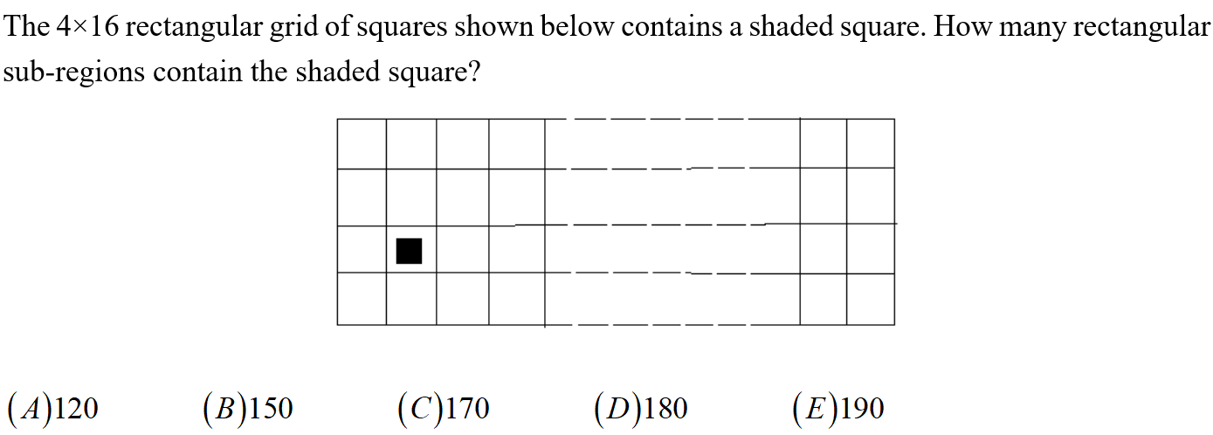
Practice 6

Slide 22
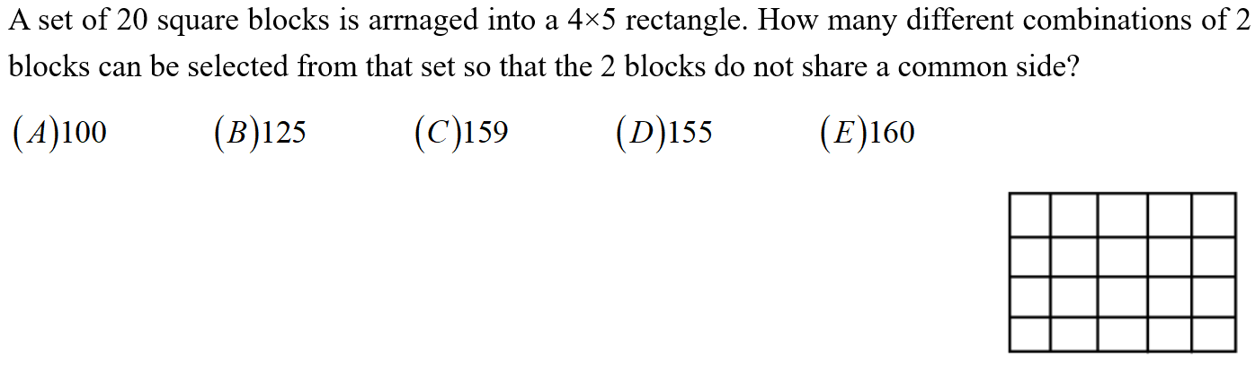
Practice 7

Slide 23
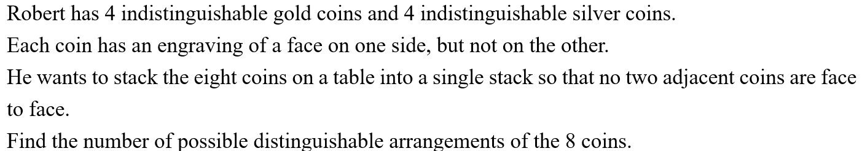
Practice 8

Slide 24
We have learnt…
Counting I-Basic Rule
Counting II-Permutation
Counting III-Combination
Counting-Balls and Boxes
Triangle Area and Area Method
Similar Triangle III
Coordinate Geometry III

Slide 25
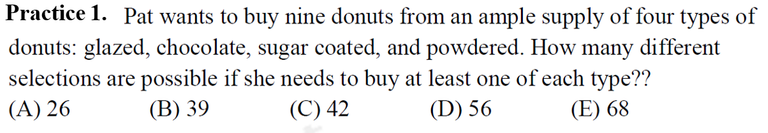
Practice 1

Slide 26
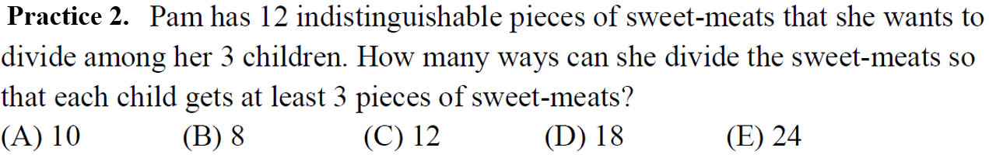
Practice 2

Slide 27
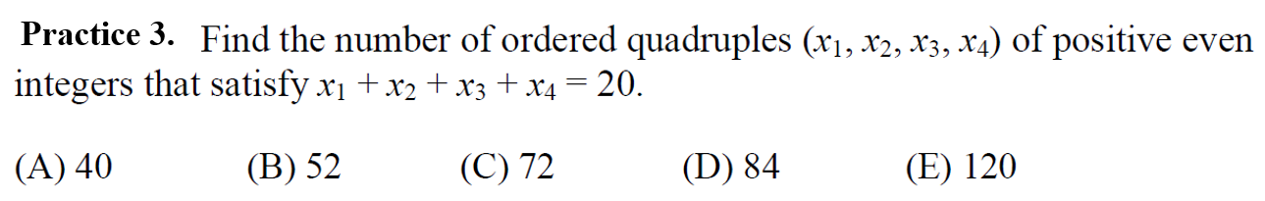
Practice 3

Slide 28
Practice 4

Slide 29
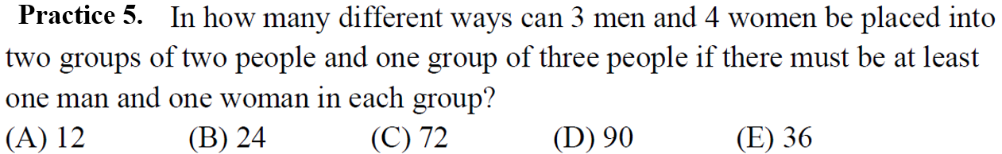
Practice 5

Slide 30
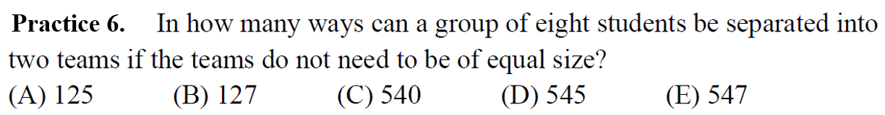
Practice 6

Slide 31
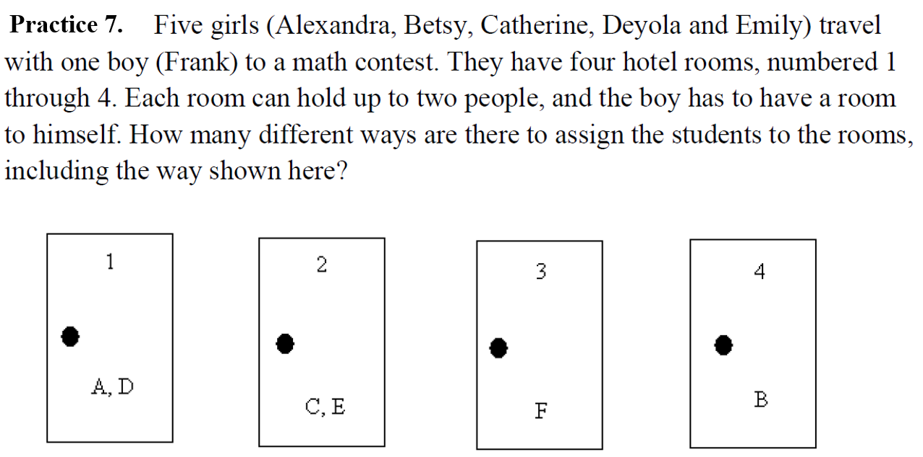
Practice 7

Slide 32
We have learnt…
Counting I-Basic Rule
Counting II-Permutation
Counting III-Combination
Counting-Balls and Boxes
Triangle Area and Area Method
Similar Triangle III
Coordinate Geometry III

Slide 33
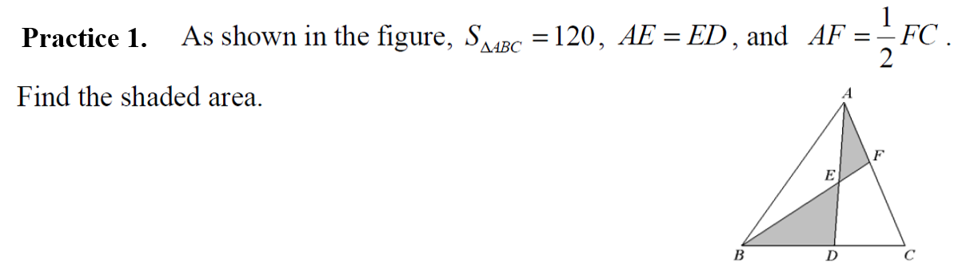
Practice 1

Slide 34
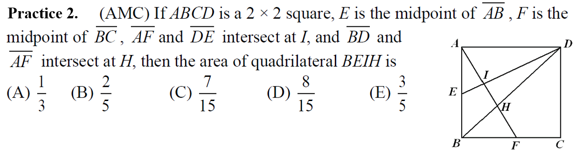
Practice 2

Slide 35
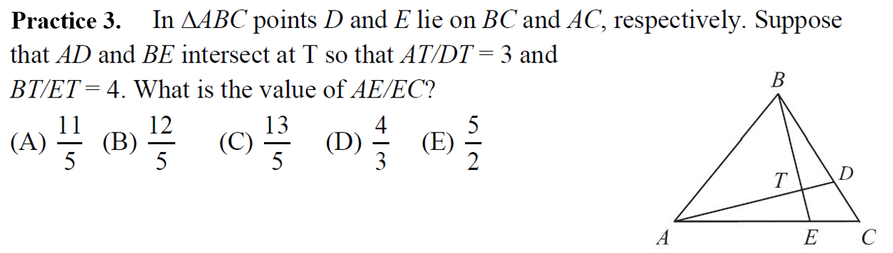
Practice 3

Slide 36
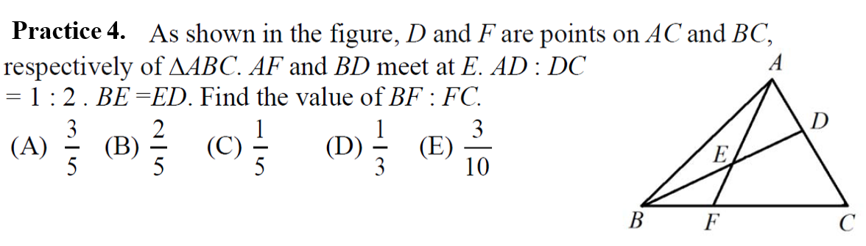
Practice 4

Slide 37
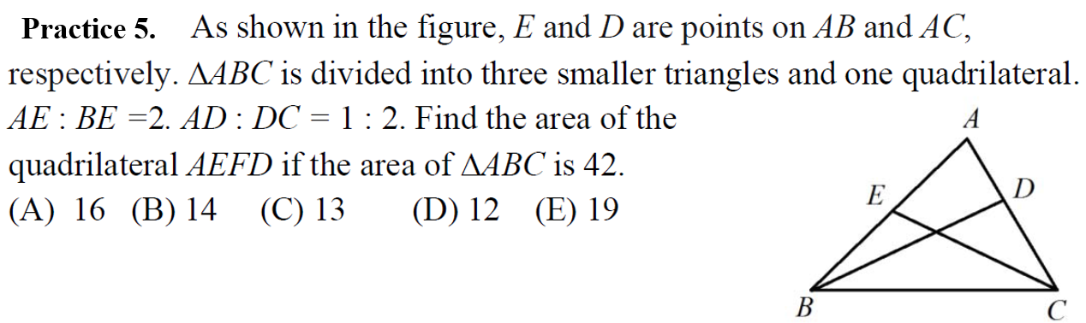
Practice 5

Slide 38
We have learnt…
Counting I-Basic Rule
Counting II-Permutation
Counting III-Combination
Counting-Balls and Boxes
Triangle Area and Area Method
Similar Triangle III
Coordinate Geometry III

Slide 39
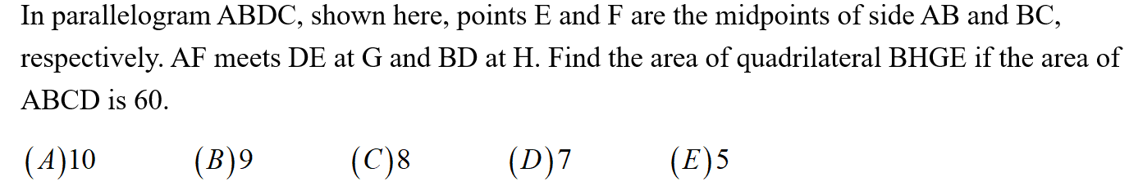
Practice 1

Slide 40
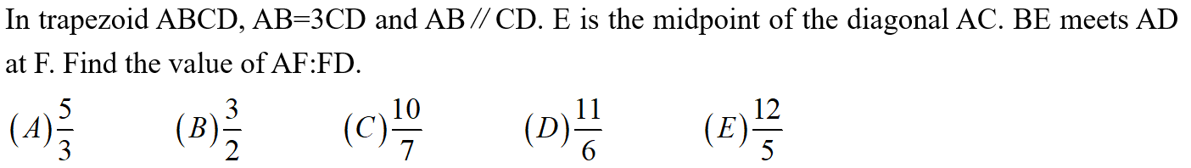
Practice 2

Slide 41
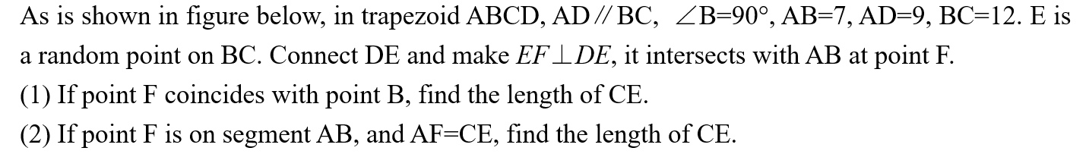
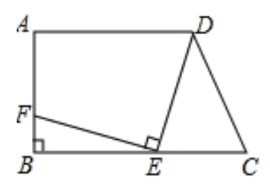
Practice 3

Slide 42
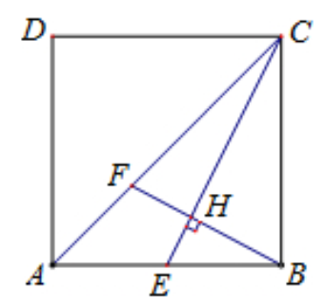
Practice 4

Slide 43
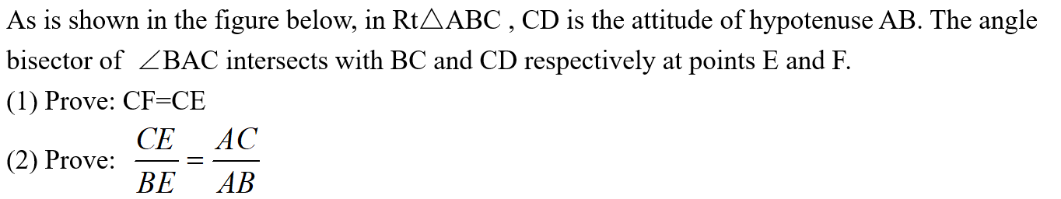
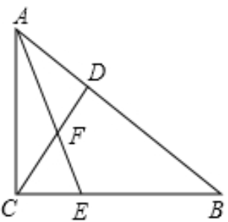
Practice 5

Slide 44
We have learnt…
Counting I-Basic Rule
Counting II-Permutation
Counting III-Combination
Counting-Balls and Boxes
Triangle Area and Area Method
Similar Triangle III
Coordinate Geometry III

Slide 45
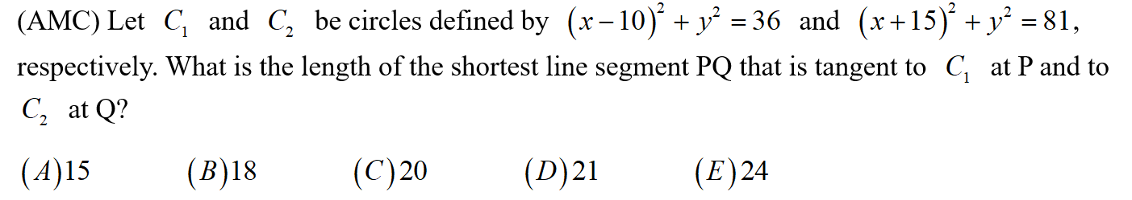
Practice 1

Slide 46
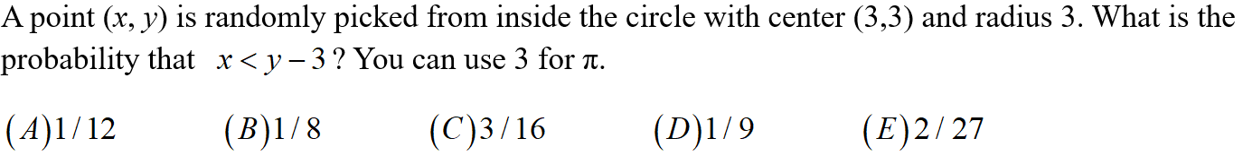
Practice 2

Slide 47
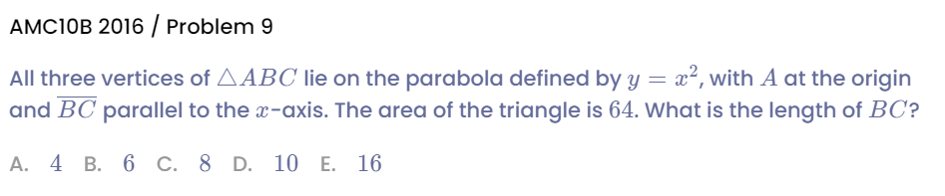
Practice 3

Slide 48
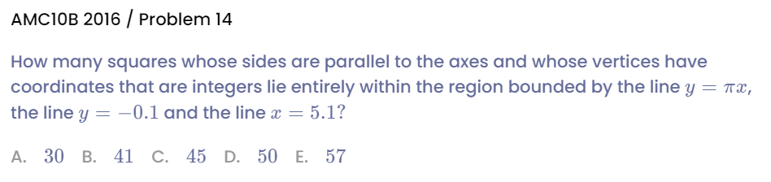
Practice 4

Slide 49
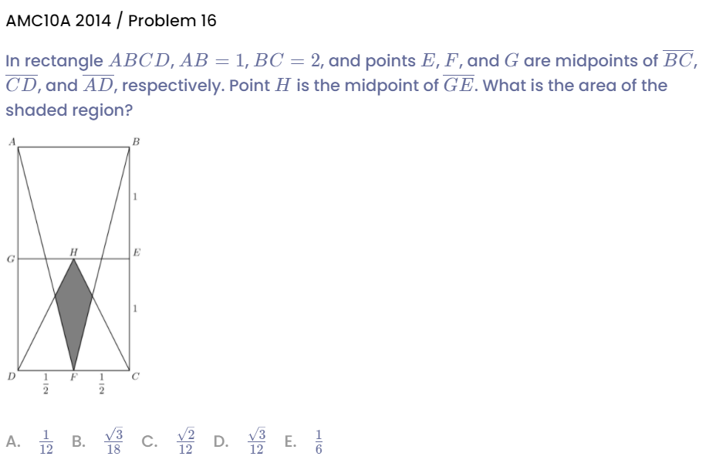
Practice 5

Slide 50
We have learnt…
Counting I-Basic Rule
Counting II-Permutation
Counting III-Combination
Counting-Balls and Boxes
Triangle Area and Area Method
Similar Triangle III
Coordinate Geometry III

Slide 51
See You Next Time!

